Slide 1
Instance Segmentation for ships in satellite imagery
0756552 繆穩慶

Slide 2
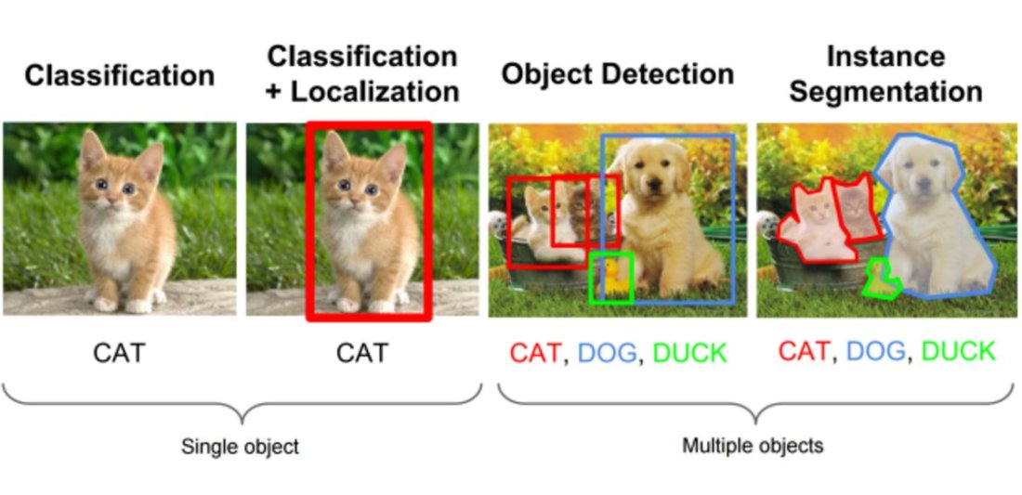
Instance Segmentation
Comparison between image classification, object detection and instance segmentation.
Image source: https://medium.com/comet-app/review-of-deep-learning-algorithms-for-object-detection-c1f3d437b852

Slide 3
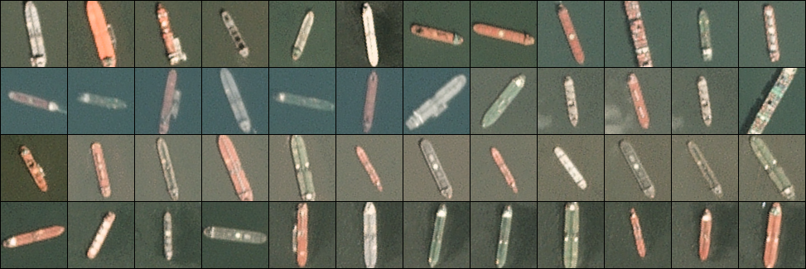
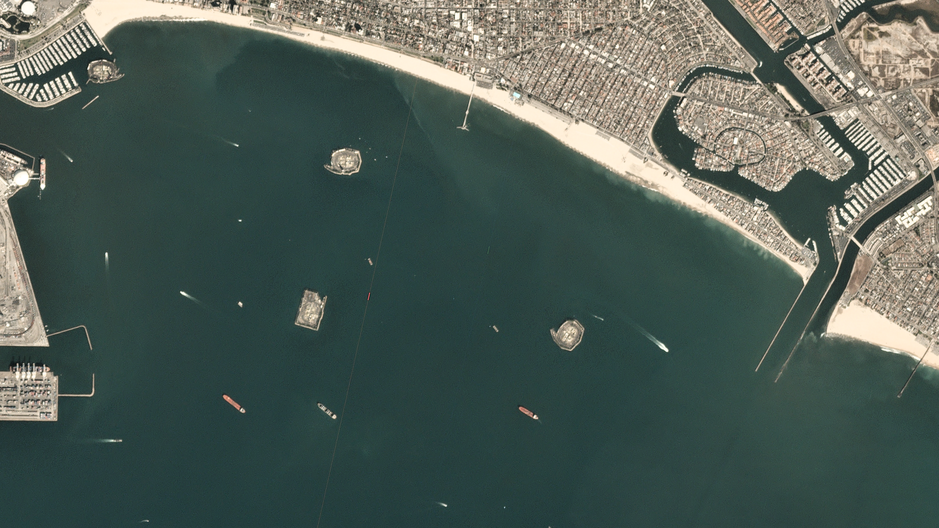
Data
Ships in Satellite Imagery
Training:
Testing
80x80 RGB
Length:1xxx~2xxx pixels
Width: 2xxx~3xxx pixels

Slide 4
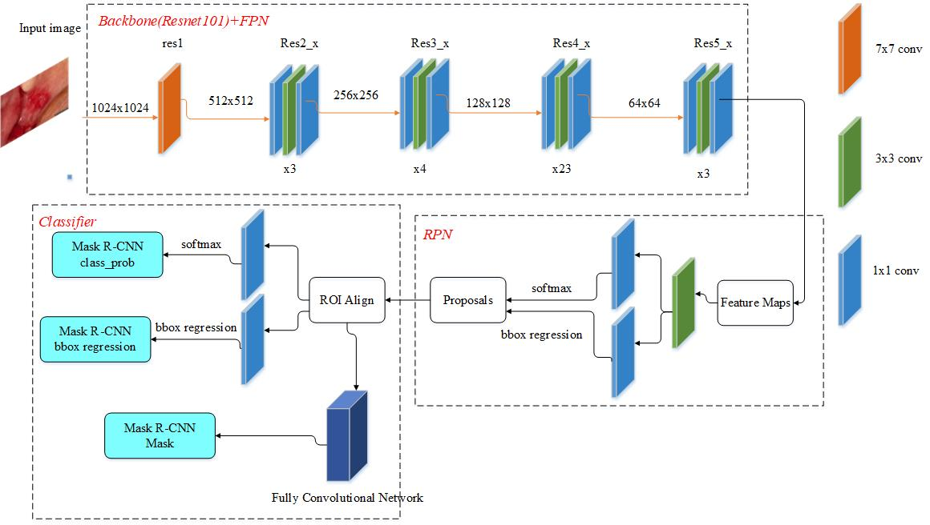
Model
Mask R-CNN[1] : A state-of-the-art framework for object instance segmentation.

Slide 5
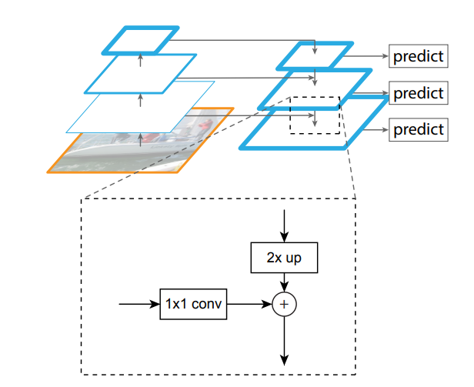
Model
Feature Pyramid Network (FPN)[2]:
The motivation of FPN is to fully extract multiscale feature maps.
Notes:
優點增加!
- multicast

Slide 6
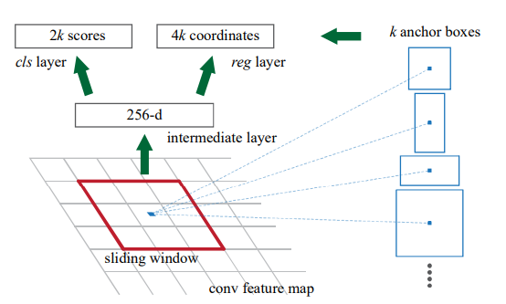
Model
Region Proposal Network (RPN)[3]:
Notes:
優點增加!
- multicast

Slide 7
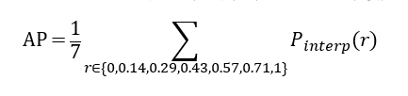
Evaluation Metric
Precision = TP / (TP+FP)
Recall = TP / (TP+FN)
VOC-Style AP:
mAP : Average AP of per class

Slide 8
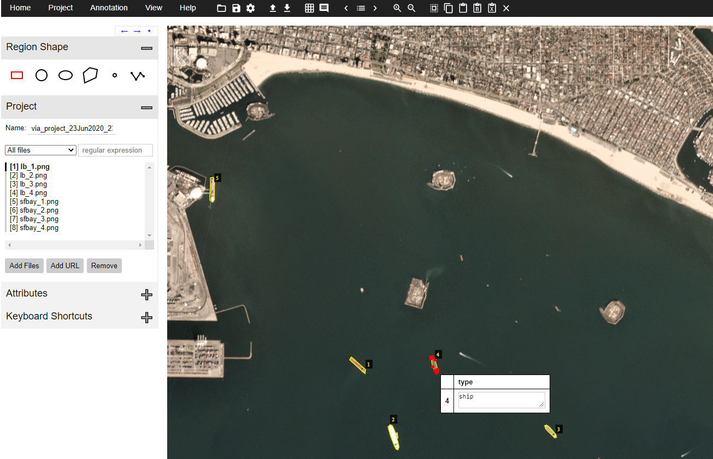
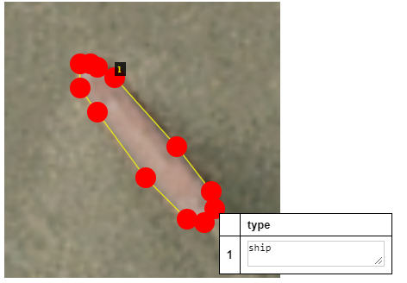
Data preprocessing
Ground Truth Generation: VGG Image Annotator(VIA)
The VIA tool saves the annotations in a JSON file, and each mask is a set of polygon points.

Slide 9
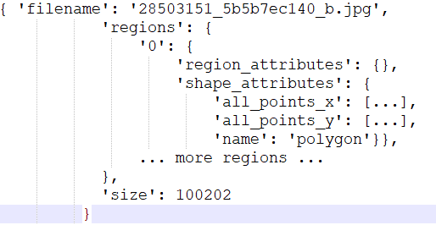
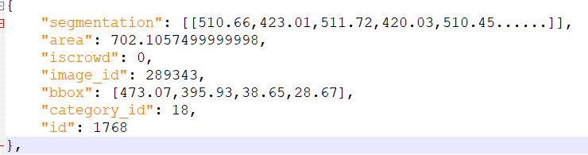
Data preprocessing
The example training code of Mask R-CNN accept annotation file of MS CoCo format, we modify it to accept VIA format.
MS CoCo format :
VIA format :
Notes:
優點增加!
- multicast

Slide 10
Data preprocessing
Image Resizing
Since one ship in the testing image is much smaller than in the training image, we resize training images as small as possible and testing images as large as possible to get better result.
Training : from 80x80 to 256x256(The smallest size the model can accept)
Testing : Compare 2048x2048 and 3072x3072
Notes:
優點增加!
- multicast

Slide 11
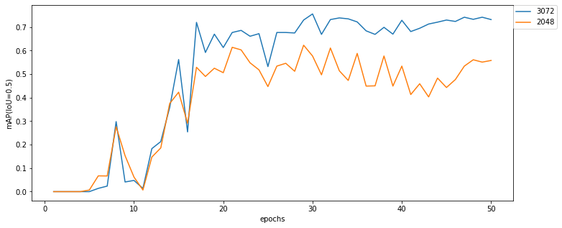
Data preprocessing
Image Resizing
Image Size | mAP(%, IoU = 0.5) | Inference time(s)
2048x2048 | 61.4 | 9.21
3072x3072 | 75.6 | 19.1
Notes:
優點增加!
- multicast

Slide 12
Data preprocessing
Data augmentation
Our model will randomly apply 1~3 of these operation at each epoch with some probability, including:
Flip/mirror input images horizontally/vertically.
Apply affine transformations to images(rotate).
Add a value to all pixels in an image.
Multiply all pixels in an image with a specific value, thereby making the image darker or brighter.
Blur images using gaussian kernels.
Notes:
優點增加!
- multicast

Slide 13
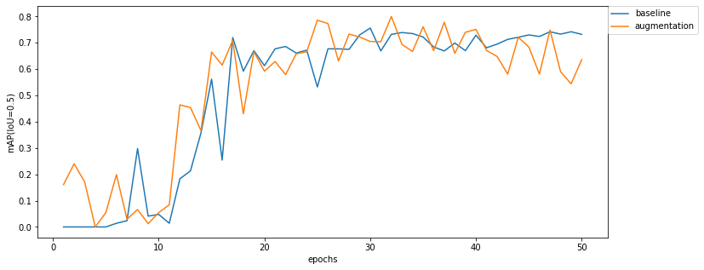
Data preprocessing
Data augmentation
Notes:
優點增加!
- multicast

Slide 14
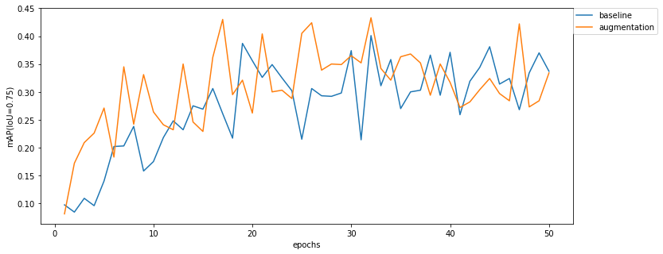
Data preprocessing
Data augmentation
 | mAP(%, IoU = 0.5) | mAP(%, IoU = 0.75)
baseline | 75.6 | 40.1
Augmentation | 80.0 | 43.3
Notes:
優點增加!
- multicast

Slide 15
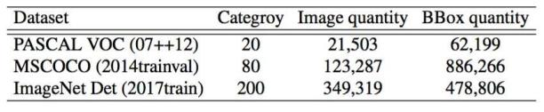
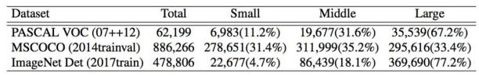
Pretrained
All the experiments before is based on COCO pretrained weight, we also try ImageNet pretrained weight, but we got almost zero mAP. The reason may be that COCO is a dataset for object detection and segmentation.
Notes:
優點增加!
- multicast

Slide 16
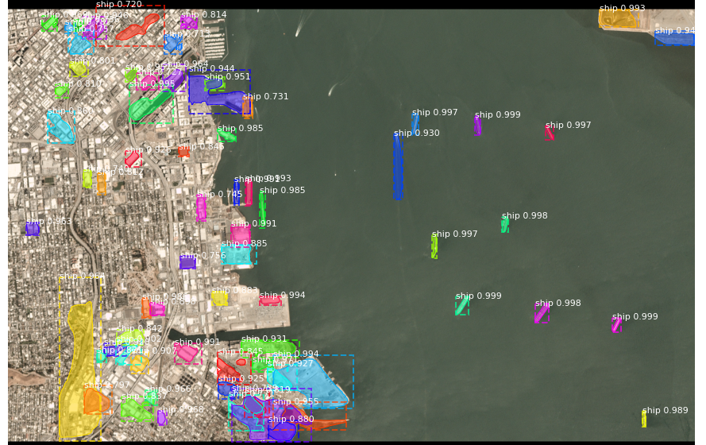
Detection results
Problem : Too many false positive
Notes:
優點增加!
- multicast

Slide 17
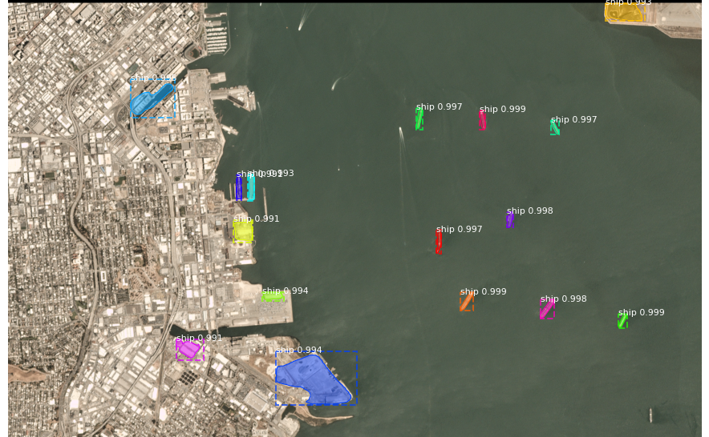
Detection results
Solution: Set DETECTION_MIN_CONFIDENCE higher
DETECTION_MIN_CONFIDENCE = 0.99
Notes:
優點增加!
- multicast

Slide 18
References
[1]G. G. Kaiming He, Piotr Dollár, Ross Girshick, "Mask R-CNN," presented at the Computer Vision (ICCV), 2017 IEEE International Conference on, 2017.
[2] T.-Y. Lin, P. Dollar, R. Girshick, K. He, B. Hariharan, and ´ S. Belongie. Feature pyramid networks for object detection. In CVPR, 2017.
[3] S. Ren, K. He, R. Girshick, and J. Sun. Faster R-CNN: Towards real-time object detection with region proposal networks. In NIPS, 2015.

